Slide 1
Machine Learning Using Python
Faculty: Dr Arpana Chaturvedi

Slide 2
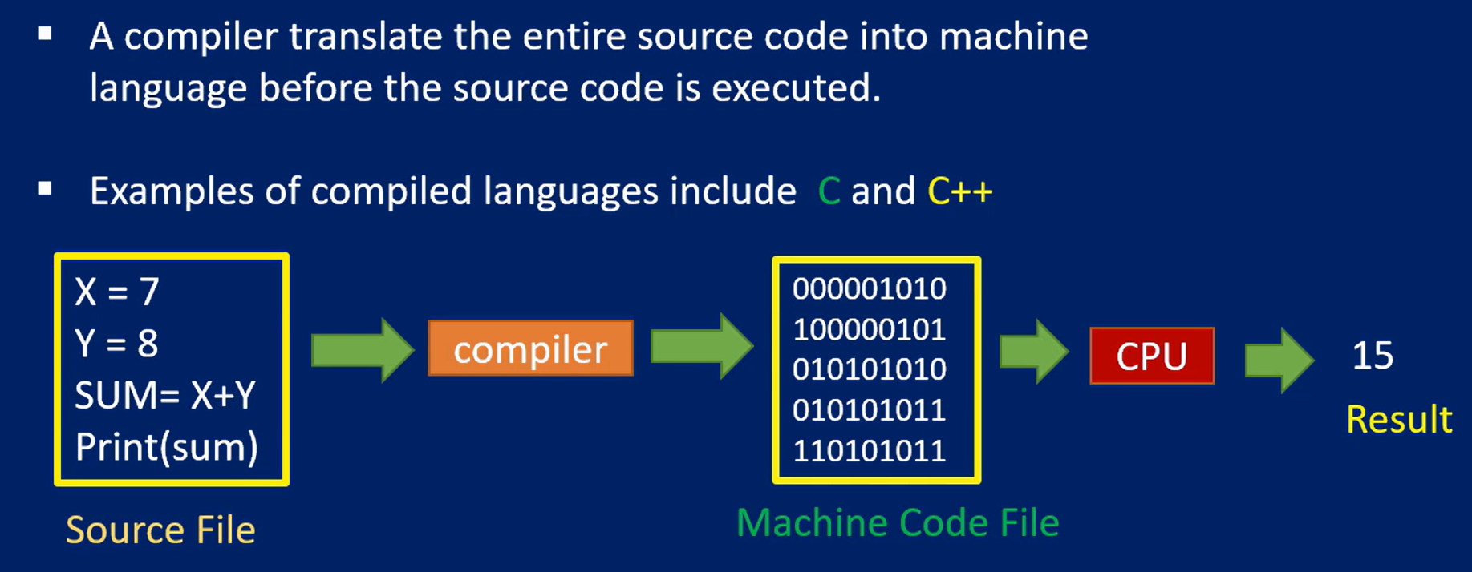
Compiler

Slide 3
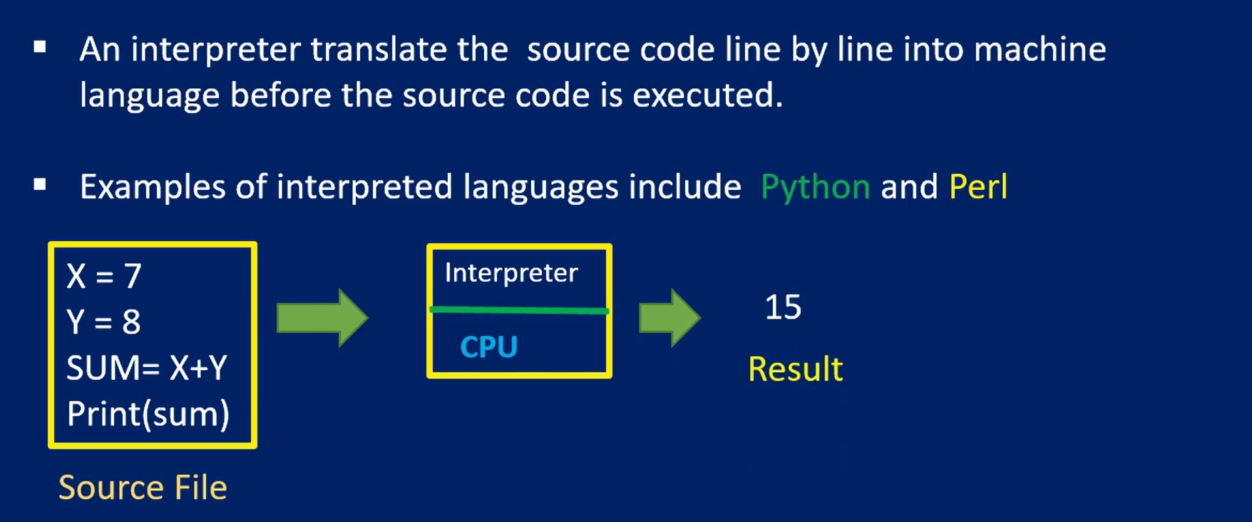
Interpreter

Slide 4
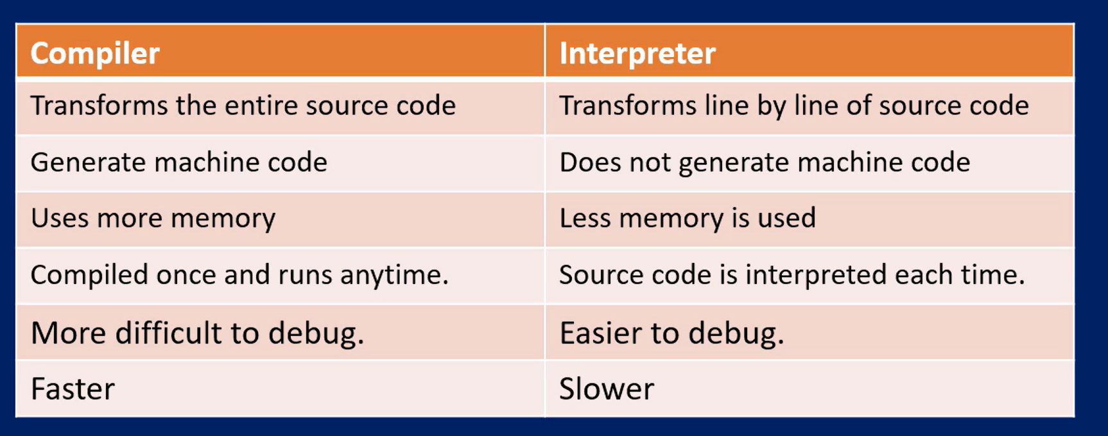
Compiler Vs Interpreter
Python is an interpreted language, which means it primarily uses an interpreter to execute its code.
But it involves both compilation (to bytecode) and interpretation (execution of bytecode). Learning about compilers and interpreters helps you grasp how Python processes your code from .py to executable instructions.

Slide 5
Python Introduction
Python is a general purpose language developed by Guido van Rossum.
Python is used in data science, web programming, game development, desktop applications and many other scientific applications.
Python is a scripting language with structured programming style.
Python has a dynamic built in data structure
Python has database connectivity interfaces to MySQL, Oracle, PostgreSQL etc.
Python is an extensible language that can be easily integrated with other programming languages such as C, C++ etc.
Python has libraries for internet protocols like HTML, XML, JSON etc., which helps for web application development

Slide 6
Python Environment
Anaconda is the most widely used Python distribution for data science and comes pre-loaded with all the most popular libraries and tools.
Anaconda Navigator is a desktop GUI that comes along with Anaconda Individual Edition.
The Jupyter notebook application allows you to create and edit documents that display the input and output of a Python or R language script.
Jupyter notebook integrates code and its output into a single document that combines visualizations, narrative text, mathematical equations, and other rich media.

Slide 7
Anaconda
Anaconda is a distribution of Python and R designed specifically for data science and machine learning. It simplifies package management and deployment and includes many pre-installed libraries and tools.
Key Features:
Package Manager: Uses conda for managing packages and environments.
Pre-installed Libraries: Includes popular libraries like NumPy, pandas, Matplotlib, TensorFlow, and Scikit-learn.
Environment Management: Allows creating isolated environments to avoid conflicts between package versions.
Cross-platform: Works on Windows, macOS, and Linux.
Advantages:
Easy setup for data science projects.
Eliminates dependency conflicts.
Includes tools like Jupyter Notebook, Spyder, and RStudio.

Slide 8
Jupyter
Jupyter Notebook is an open-source web application that allows you to create and share documents containing live code, equations, visualizations, and narrative text.
Key Features:
Interactive Coding: Supports running code interactively in cells.
Supports Multiple Languages: Python, R, Julia, and more via kernels.
Visualization Integration: Works seamlessly with visualization libraries like Matplotlib and Seaborn.
Markdown Support: Allows writing explanatory text alongside code.
Advantages:
Ideal for exploratory data analysis (EDA).
Facilitates collaboration by sharing “.ipynb” files.(File extension)
Suitable for educational purposes.

Slide 9
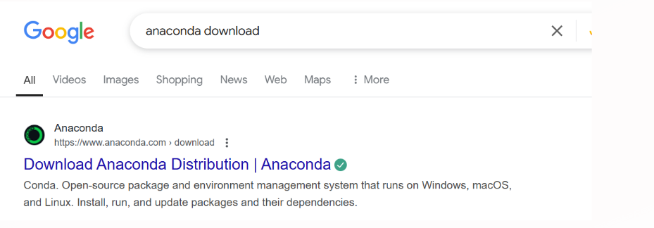
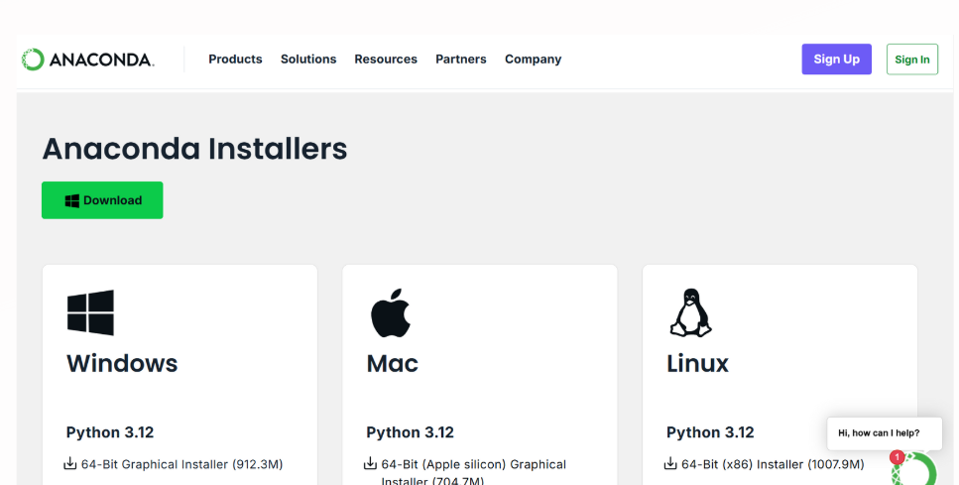
Download : Installation

Slide 10
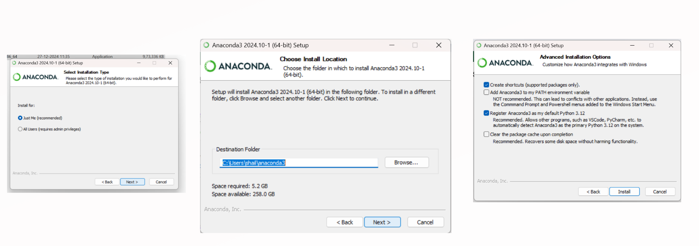
Download : Installation

Slide 11
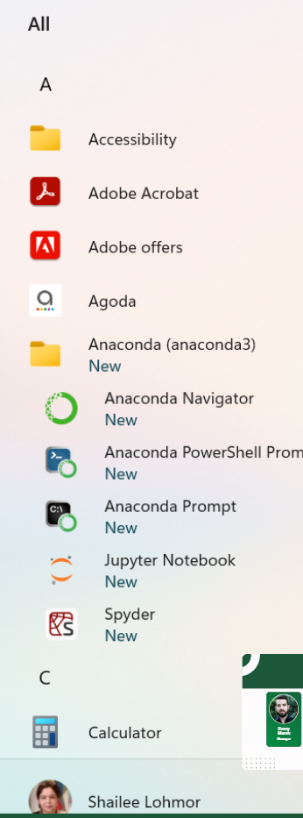
Anaconda Navigator: A graphical user interface for managing environments, packages, and launching applications like Jupyter Notebook, Spyder, and RStudio. Jupyter Notebook: A web-based tool for writing and executing live Python code, visualizing data, and creating interactive documents. Spyder: An integrated development environment (IDE) for Python, designed for data science and scientific computing with advanced debugging and variable exploration. Anaconda Prompt: A command-line interface pre-configured for managing Anaconda environments and running Python/Conda commands. Anaconda Powershell Prompt: A Windows Powershell interface optimized for working with Conda environments and packages, providing more scripting capabilities.

Slide 12
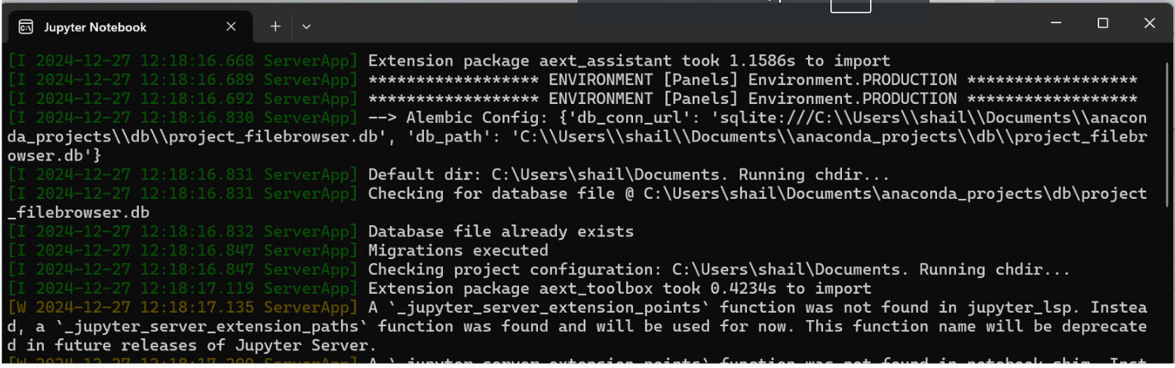
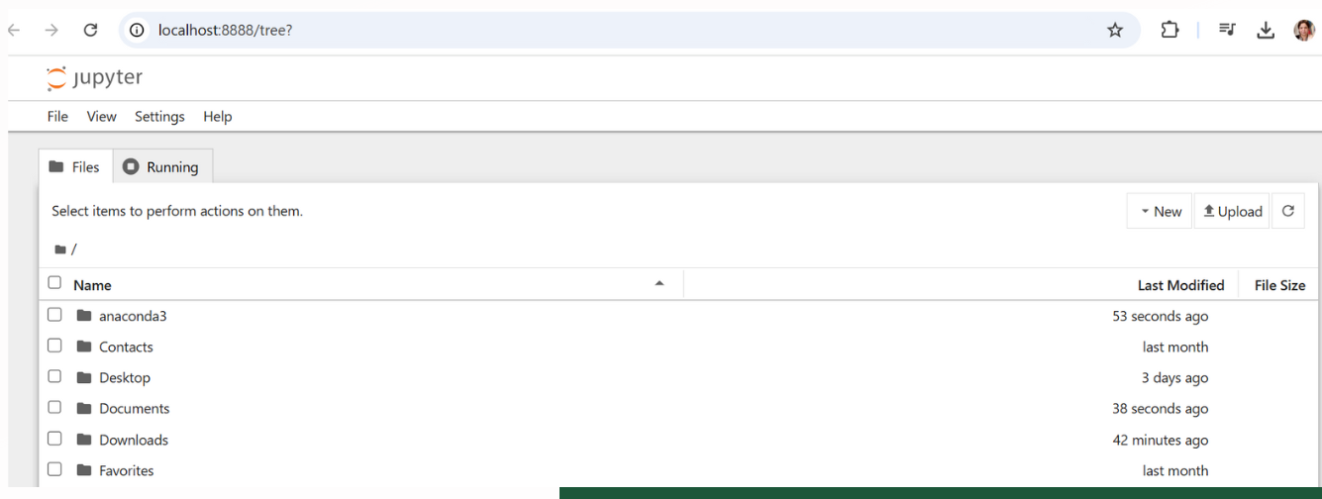
Launching Jupyter Notebook
Localhost:8888

Slide 13
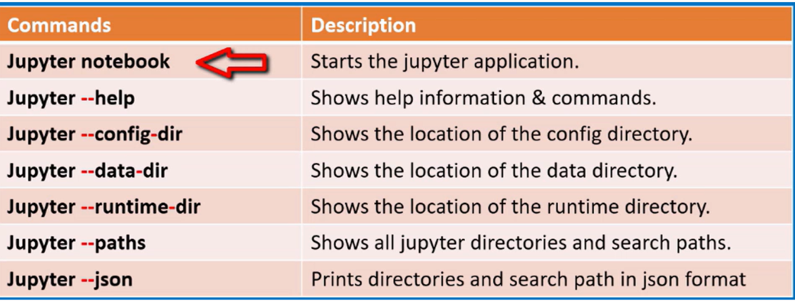
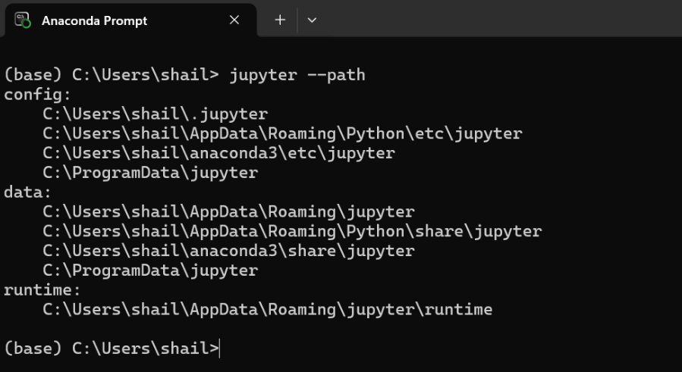
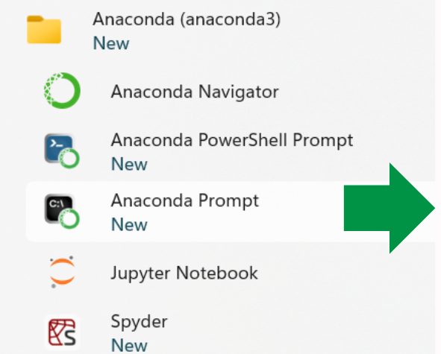
Basic - Jupyter Commands

Slide 14
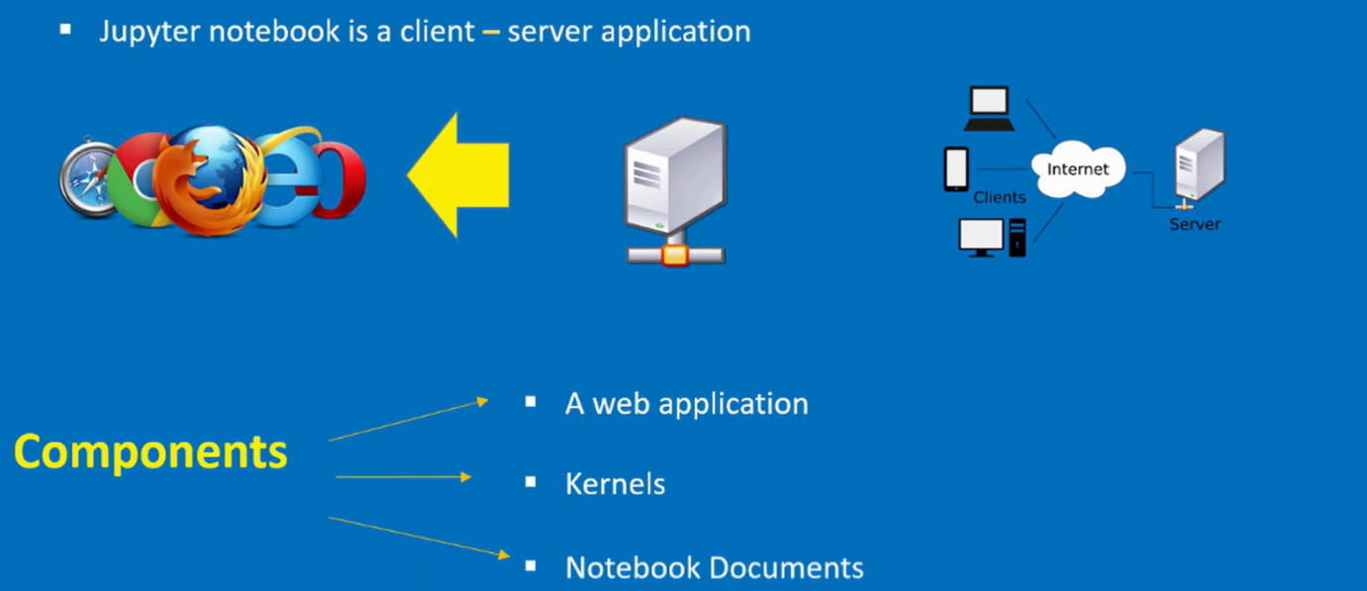
Components of Jupyter Notebook

Slide 15
Components of Jupyter Notebook
Web Application:
This is basically an interactive web application that you can use to write around your code interactively.
Kernel :
The second Jupiter notebook component is called the kernels the kernels basically are separate processes started by the notebook web application and it usually runs in the user's code and it runs in a given language.
The default language is Python but it can run in other languages and what it does it returns the output from the notebook web application back to the notebook web application and the kernel basically handles things like complete computations for interactive widgets tab completion introspection and other bits and pieces. So the kernel basically interacts with the notebook web application.
Notebook Document
The Notebook document the notebook document is basically a self-contained document that contains a representation of all the content that is visible inside the notebook web application. This includes the inputs you have and also the outputs which are produce from the kernel.

Slide 16
Create a Jupyter Notebook

Slide 17
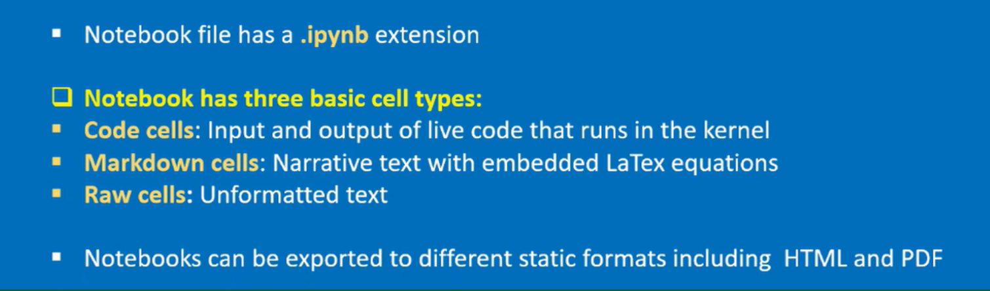

Slide 18
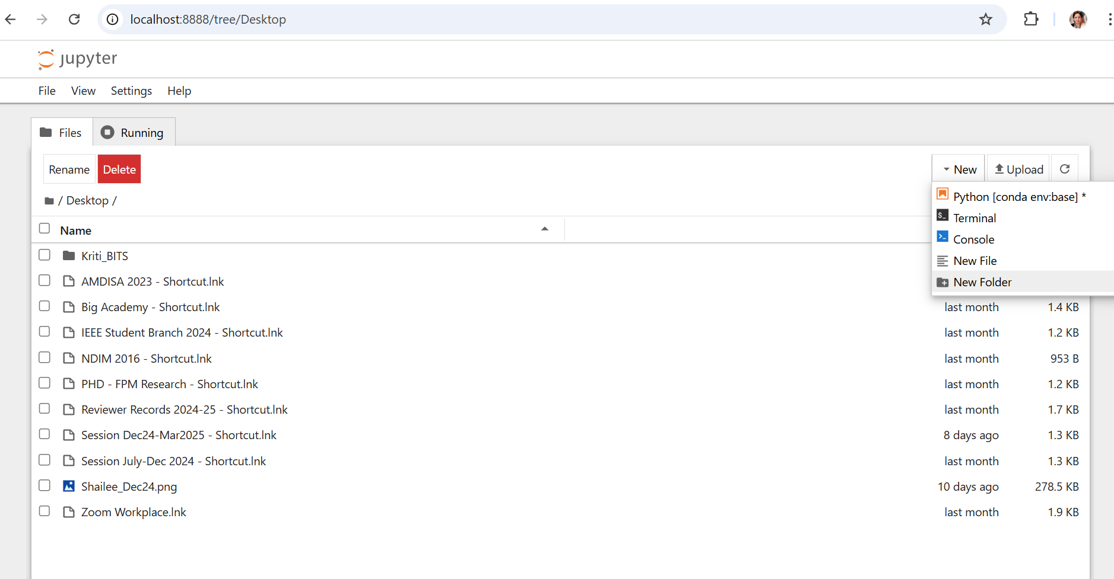
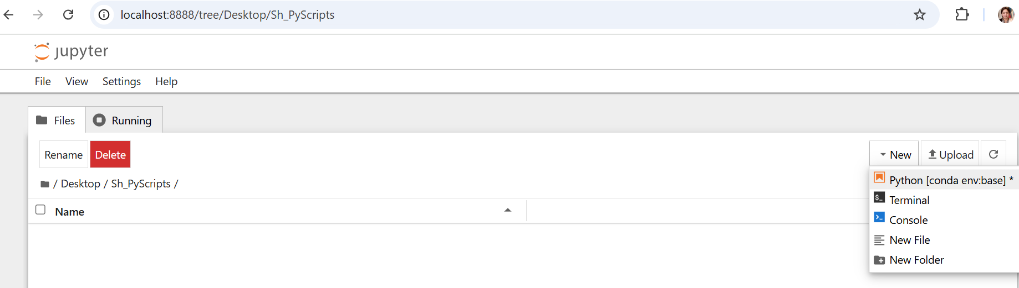
Create Folder and Python Script File

Slide 19
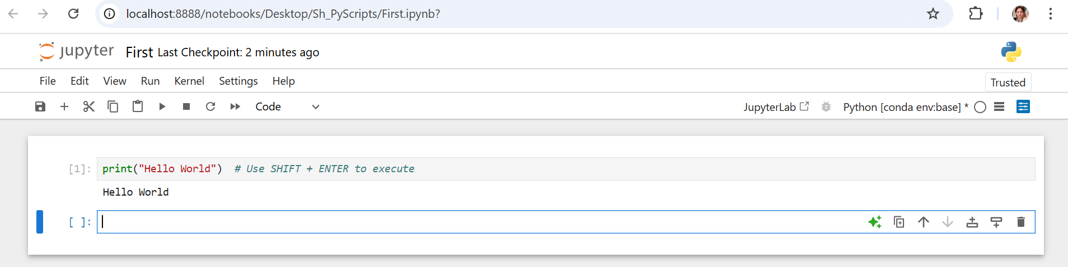
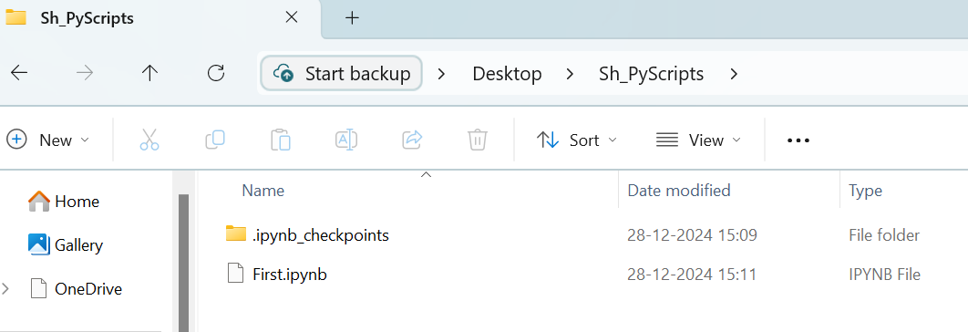
First Notebook File
The .ipynb_checkpoints folder stores temporary backup versions of Jupyter Notebook files, enabling recovery in case of crashes or accidental closures. It is automatically managed by Jupyter.

Slide 20
Variables Datatypes Operators Conditional Statements Loops Functions
Basics Of Python

Slide 21
Variables
Variables in Python are containers for storing data. A variable is created when you assign a value to it, and you can use it to reference the data throughout your program.
Key Points About Variable Creation in Python
Dynamic Typing: Python automatically infers the type of a variable based on the value assigned.
Naming Rules:
Variable names must start with a letter or an underscore.
Can only contain letters, numbers, or underscores. Must not use spaces, special characters, or reserved keywords.
Case Sensitivity: Variable names are case-sensitive, so name and Name are considered different variables.
Reassignment: Variables can be reassigned to store different values or even different data types.
Multiple Assignments: You can assign values to multiple variables in a single line or assign the same value to multiple variables.
Type Checking: Use the type() function to check the type of a variable.
Constants: Python does not have built-in constants, but by convention, variables in all caps are treated as constants.
Temporary Variables: The underscore _ is commonly used for temporary or unused variables.
Avoid Shadowing: Avoid naming variables after built-in functions like list, str, or int.
Good Practices: Use descriptive variable names for clarity. Follow naming conventions like snake_case for variables and all caps for constants.

Slide 22
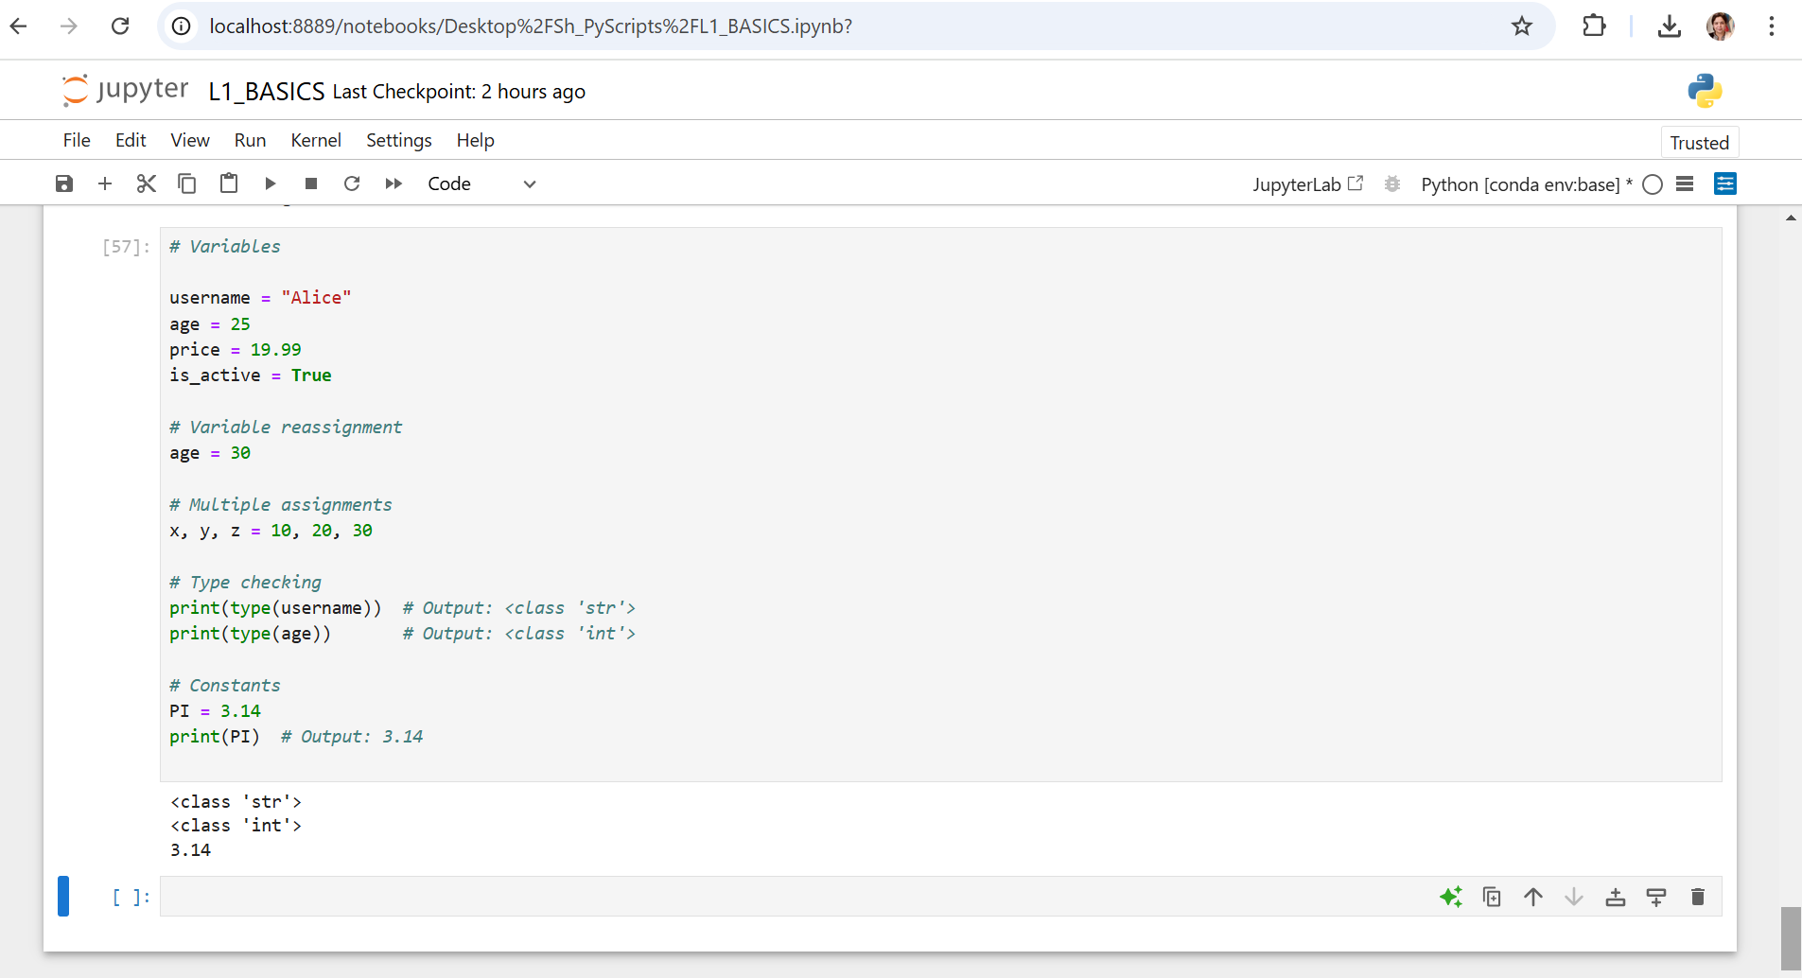

Slide 23
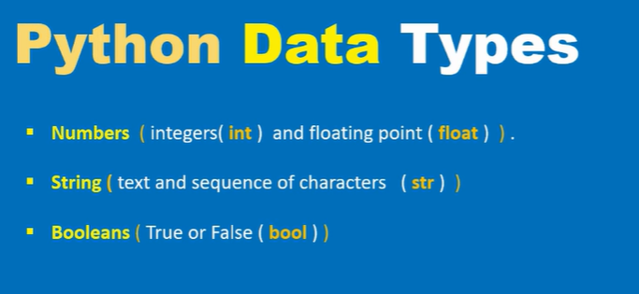
Basic Data Types

Slide 24
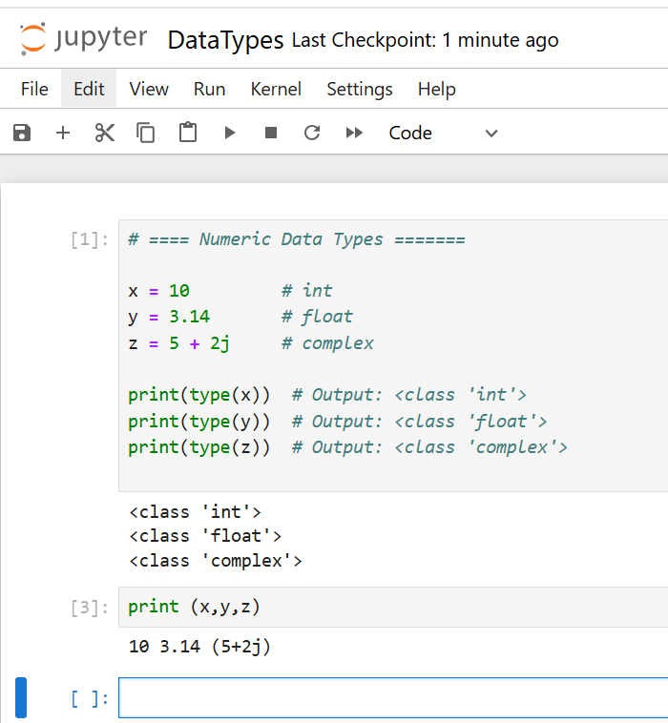
Python – Data Types
Numeric Types
int: Whole numbers, positive or negative, without decimals.
float: Numbers with decimal points or in exponential form.
complex: Numbers with real and imaginary parts (e.g., a + bj).
Important Points:
Supports arithmetic operations like +, -, *, /, %, and //.
Use int(), float(), or complex() to convert between numeric types.

Slide 25
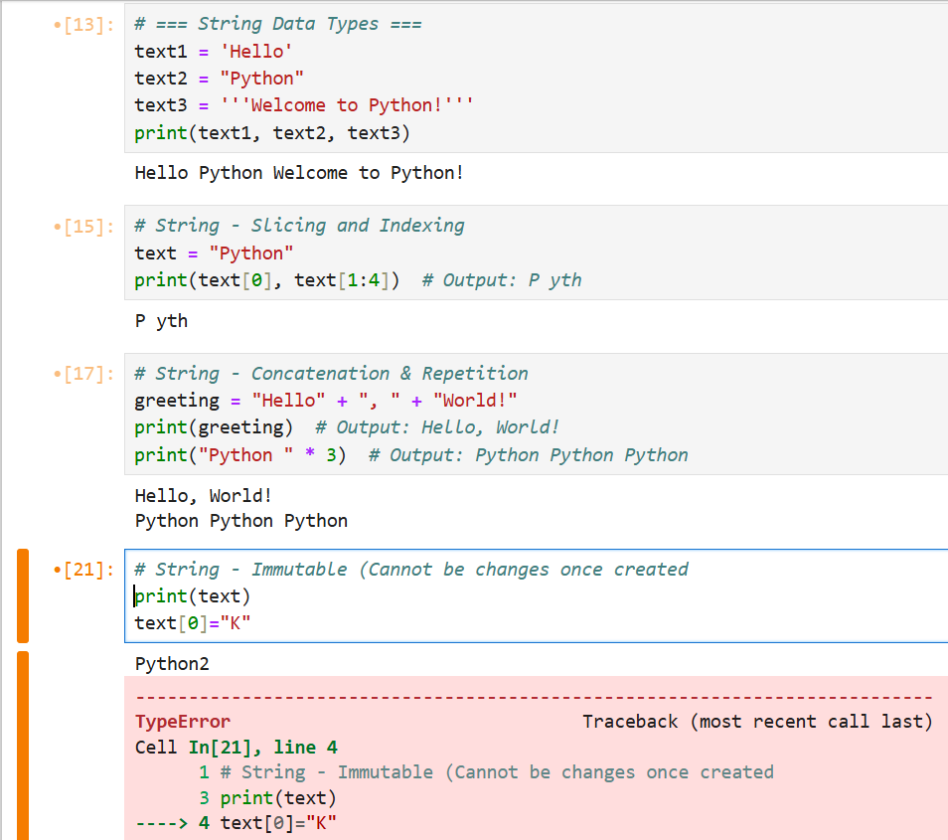
Python – Data Types
2. Text Type
str: Sequences of characters enclosed in single, double, or triple quotes for textual data.
Important Points:
Strings are immutable (Cannot be changed).
Use + for concatenation and * for repetition.
Supports indexing and slicing.

Slide 26
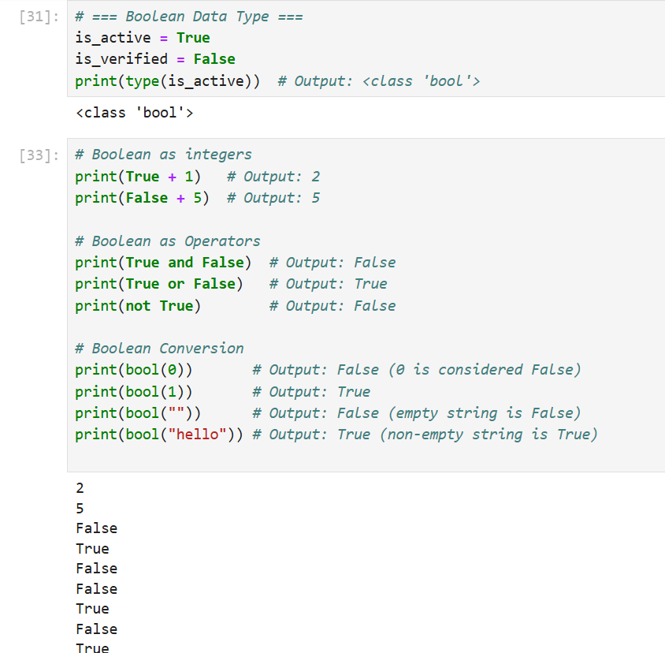
Python – Data Types
3. Boolean
Boolean (bool) represents truth values: True or False.
Commonly used for decision-making and conditional statements.
Important Points:
Boolean as Integers: True is equivalent to 1 and False is equivalent to 0 in arithmetic operations.
Boolean Values in Conditions: Often used in if, while, and other control structures.
Boolean Operators: Logical operations like and, or, and not work with Boolean values.
Boolean Conversion: Use bool() to convert values to Boolean

Slide 27
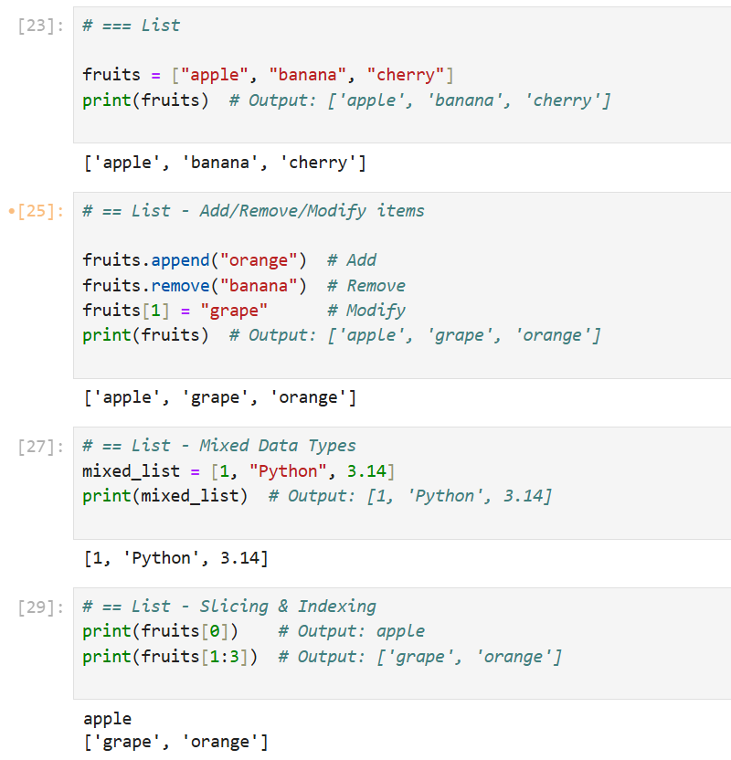
Advanced Data Types
List : Ordered, mutable collection of items enclosed in square brackets.
Important Points:
Add/Remove/ Modify items
Mixed data types
Slicing & Indexing

Slide 28
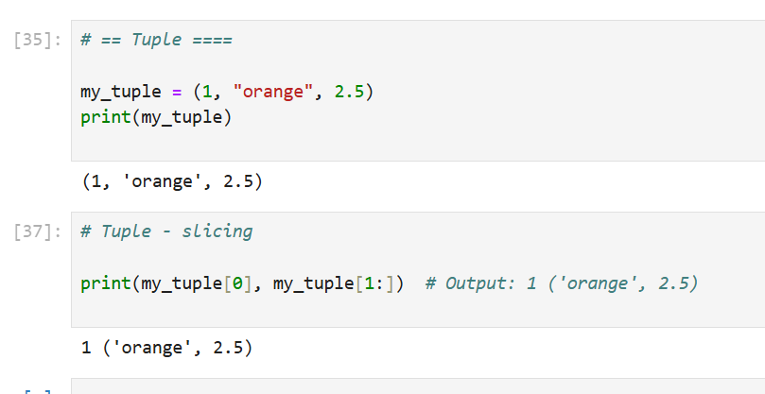
Advanced Data Types
Tuple : A tuple is an ordered, immutable collection of items separated by commas.
Important Points:
Tuples are immutable: Items cannot be added, removed, or changed.
Supports indexing and slicing
Useful for storing fixed data that should not be modified.

Slide 29
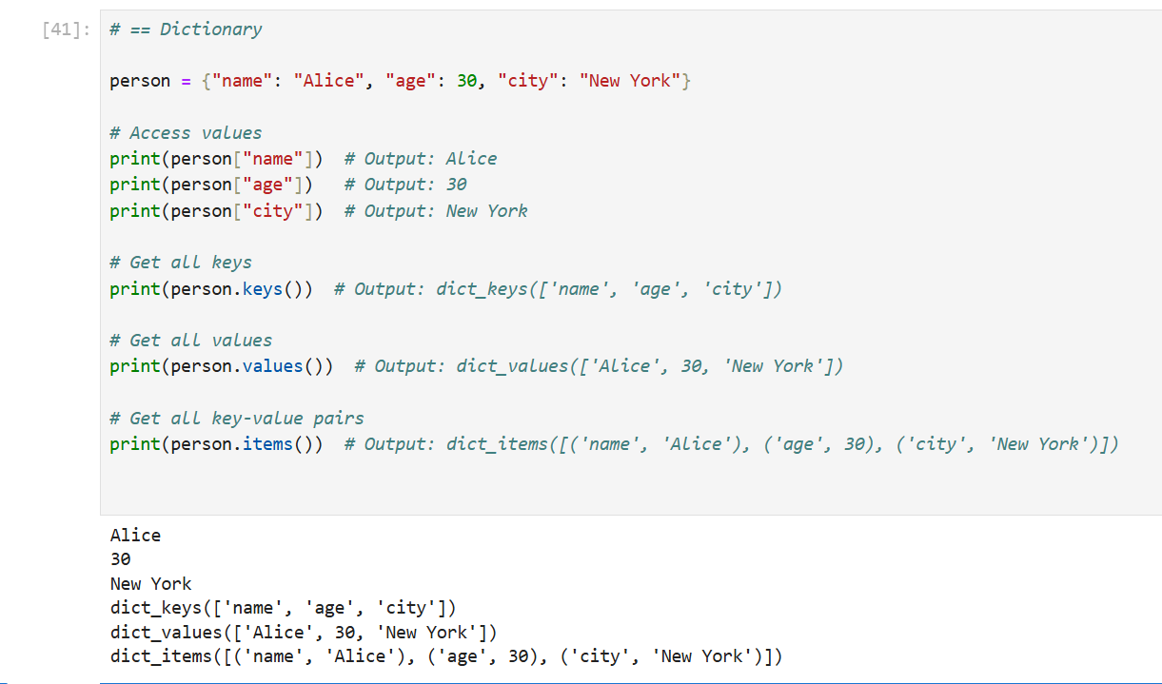
Advanced Data Types
Dictionary: A dictionary is an unordered collection of key-value pairs enclosed in curly braces ({ }).

Slide 30
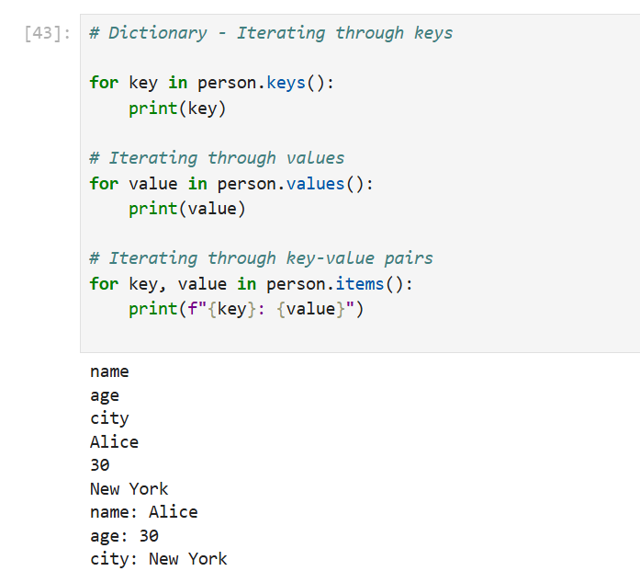
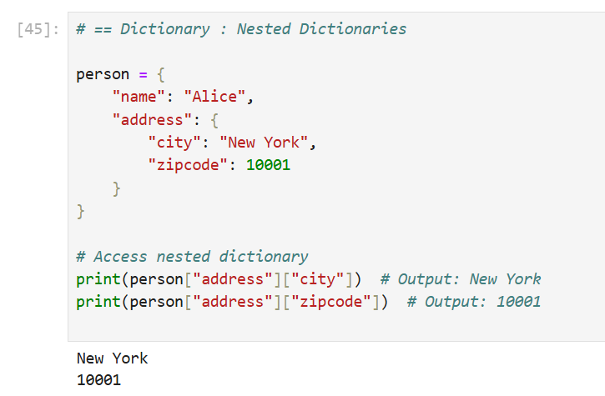
Advanced Data Types
Dictionary: Dictionaries can contain other dictionaries, and you can access values using multiple keys.

Slide 31
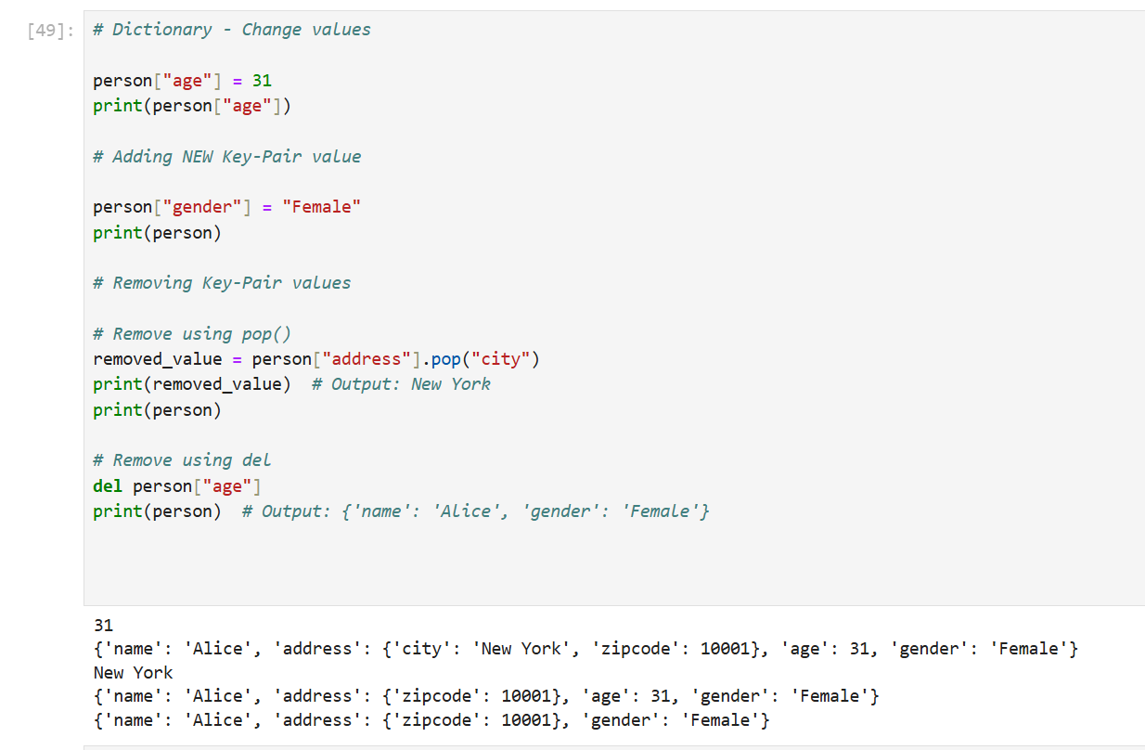
Advanced Data Types
Dictionary:
Modifying Values

Slide 32
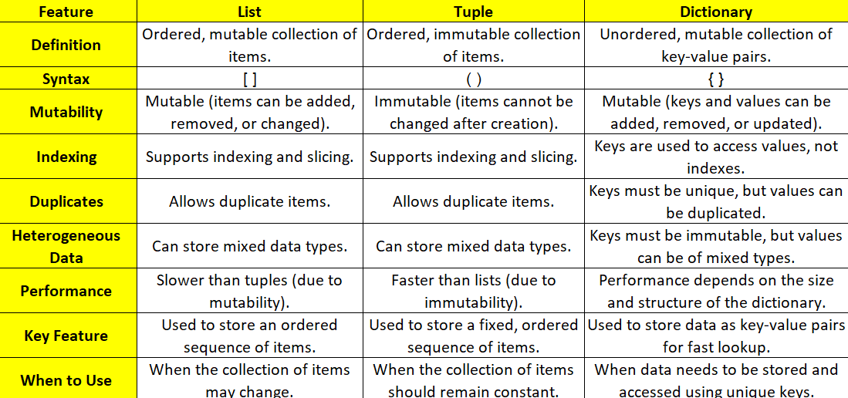
Comparison: List / Tuple / Dictionary

Slide 33
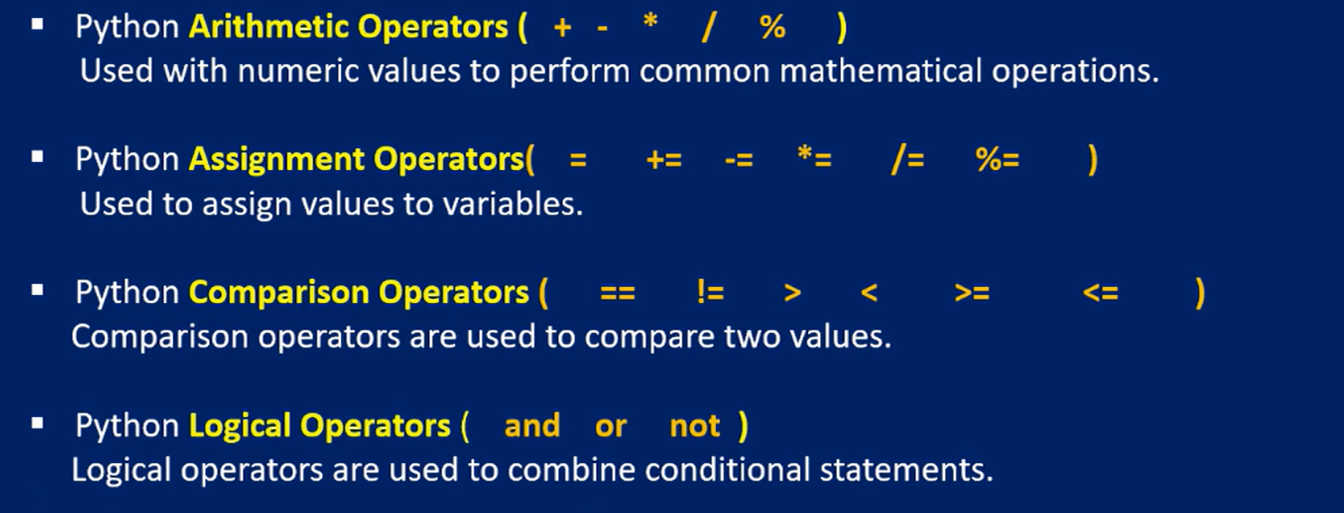
Python - Operators

Slide 34
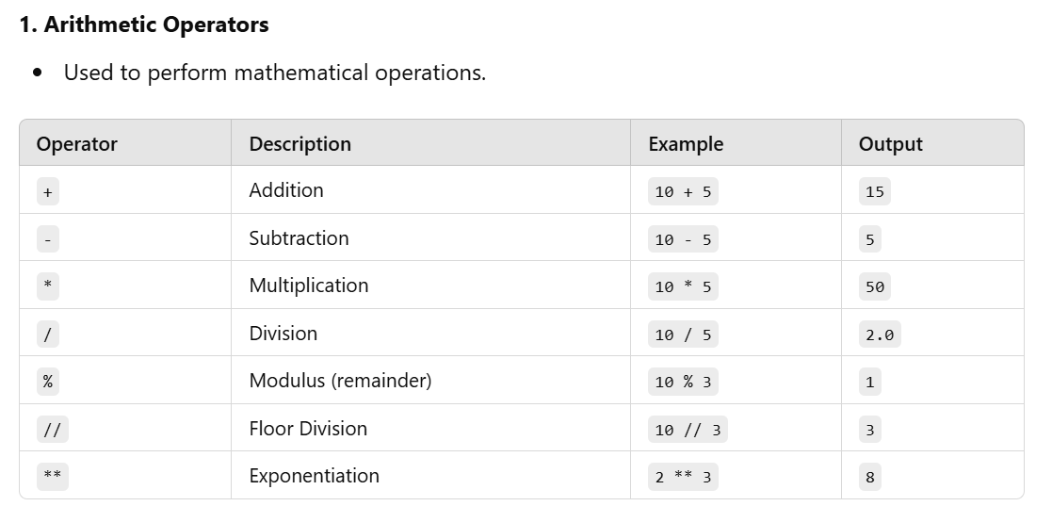
Operators

Slide 35
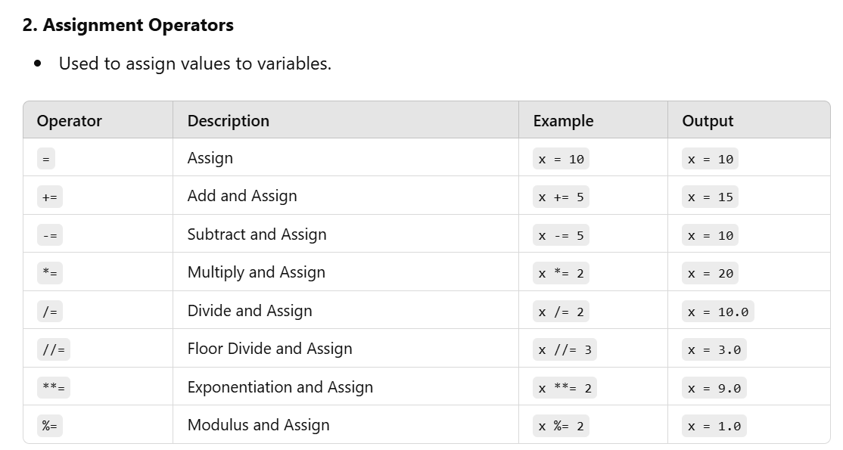
Operator

Slide 36
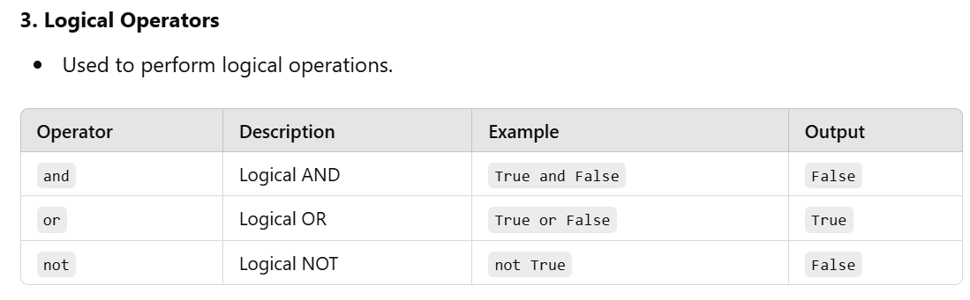
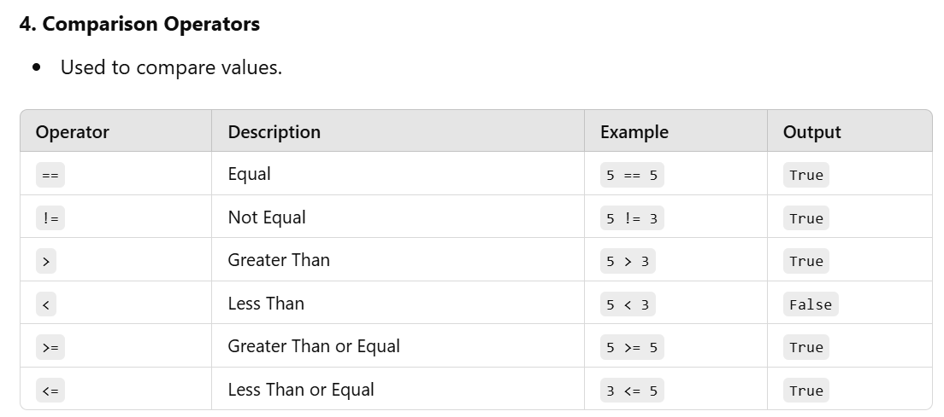
Operator

Slide 37
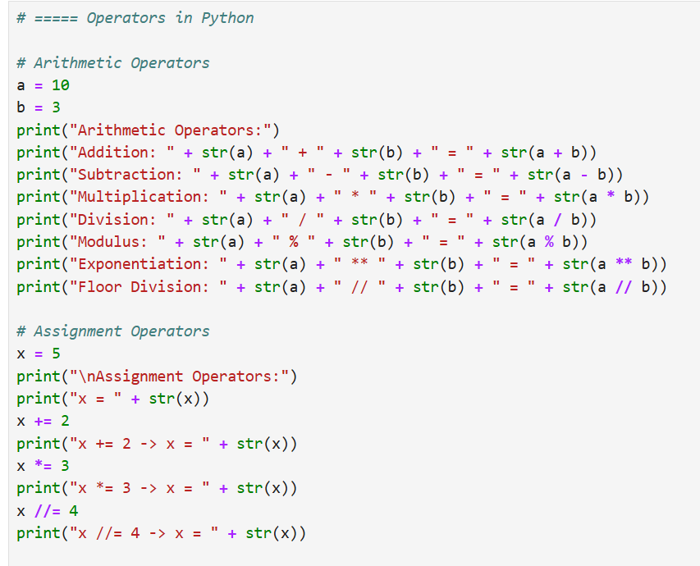
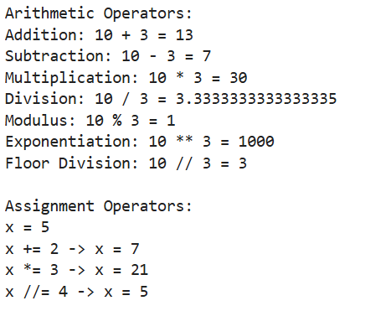
Operators – Practice

Slide 38
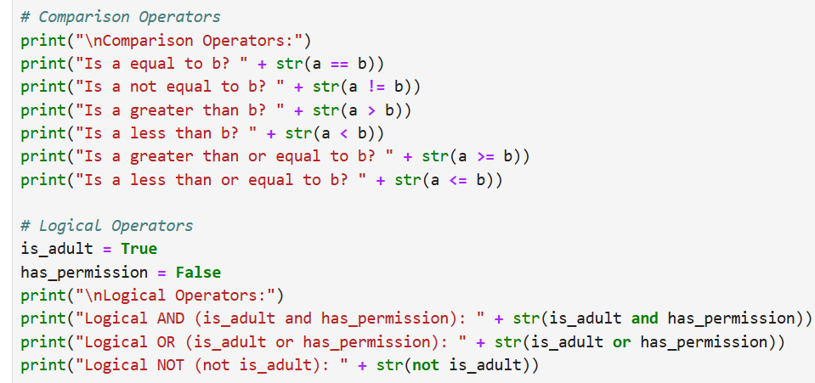
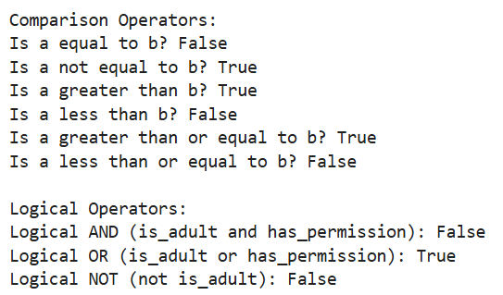
Operators – Practice

Slide 39
Conditional Statements: If/elif/Else
Conditional statements allow your program to execute certain blocks of code based on specific conditions.

Slide 40
IF STATEMENTS
The if statement evaluates a condition. If the condition is True, the block of code indented under it will execute.
The else block executes if the if condition is False.
if-elif-else Statement: Used when multiple conditions need to be checked. The elif (short for "else if") checks another condition if the previous one is False.
Nested if Statement: if statements can be nested inside each other, allowing you to check conditions within other conditions.

Slide 41
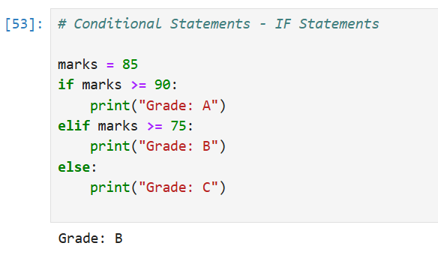
IF STATEMENTS
Key Points to Remember
Indentation:
Python uses indentation (spaces) to define the blocks of code.
Ensure consistent indentation to avoid errors.
Order of Evaluation:
Conditions are evaluated sequentially in an if-elif-else chain.
Only the first True condition executes; the rest are ignored.
Boolean Expressions:
Conditions should evaluate to True or False.
Use comparison (>, <, ==, etc.) and logical operators (and, or, not) for complex conditions.
Nested if Statements:
Useful for checking dependent conditions.
Avoid excessive nesting to keep code readable.

Slide 42
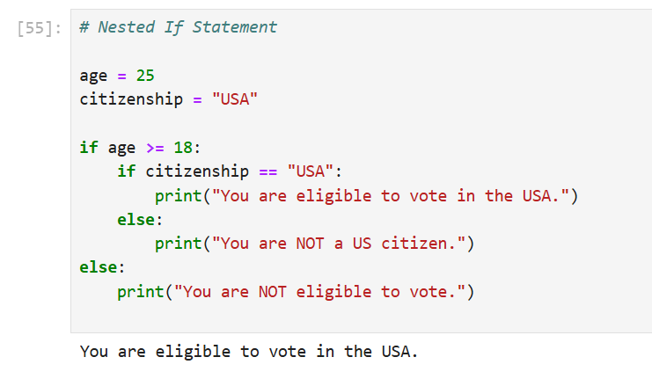

Slide 43
LOOPS – for/ while
Loops in Python allow you to execute a block of code repeatedly based on a condition or over a sequence. Python primarily uses two types of loops: for and while.

Slide 44
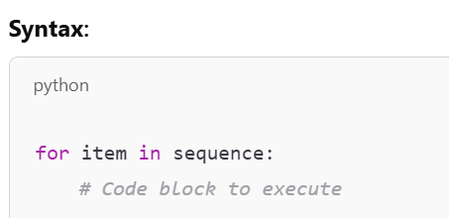
For Loop
A for loop is used to iterate over a sequence (like a list, tuple, string, or range).
It stops execution once all items in the sequence are iterated.
Key Points:
Iterates over sequences like lists, strings, tuples, dictionaries, or ranges.
Automatically stops when the sequence is exhausted.
Can use break to exit the loop prematurely and continue to skip to the next iteration.

Slide 45
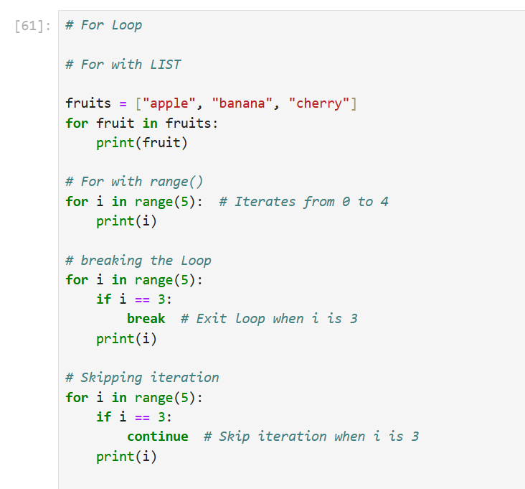
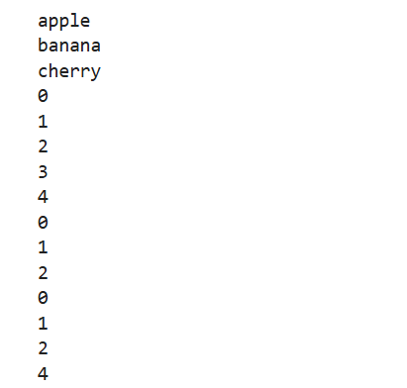

Slide 46
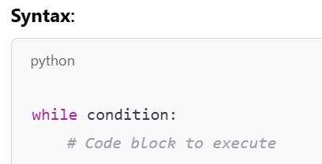
While Loop
A while loop continues to execute as long as a specified condition is True.
It is commonly used when the number of iterations is not known in advance.
Key Points:
Executes as long as the condition remains True.
Use break to exit the loop and continue to skip to the next iteration.
Be cautious of infinite loops (ensure the condition eventually becomes False).

Slide 47
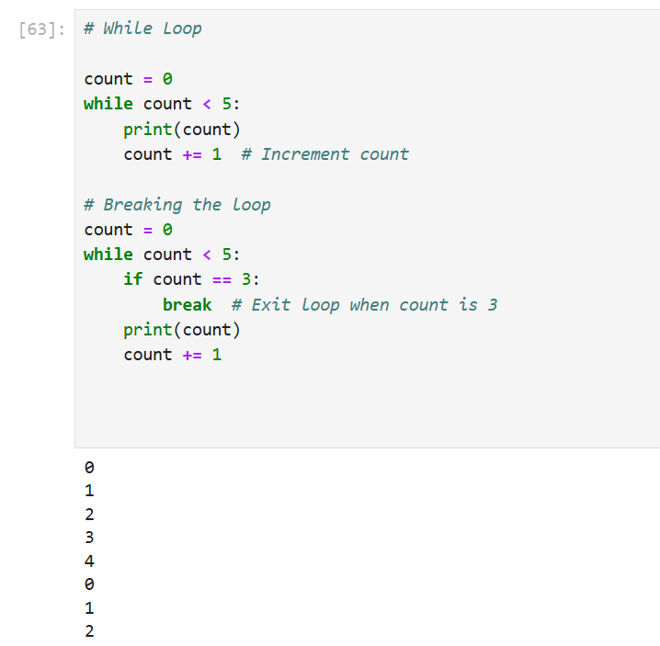
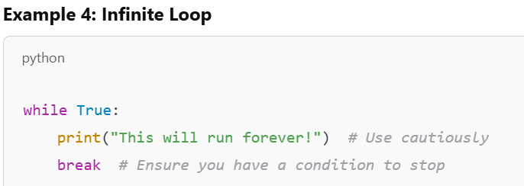
Caution Note :

Slide 48
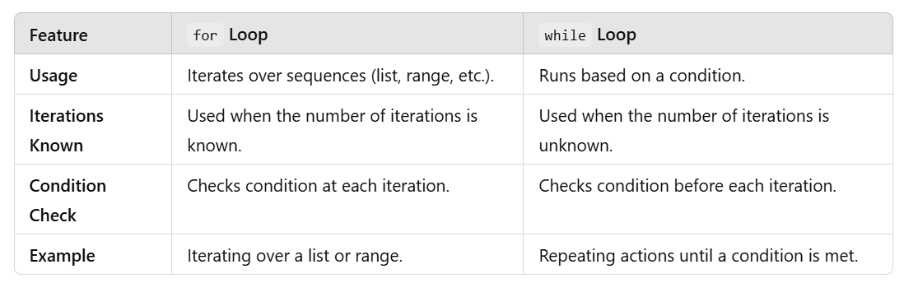
For Vs WHILE loop
Summary
Use for when iterating over a sequence or a known range of values.
Use while when the condition determines the number of iterations.
Be cautious with infinite loops, especially with while.

Slide 49
Functions
Functions are reusable blocks of code designed to perform a specific task. They are defined using the def keyword and can take parameters (inputs) and return a value (optional).

Slide 50
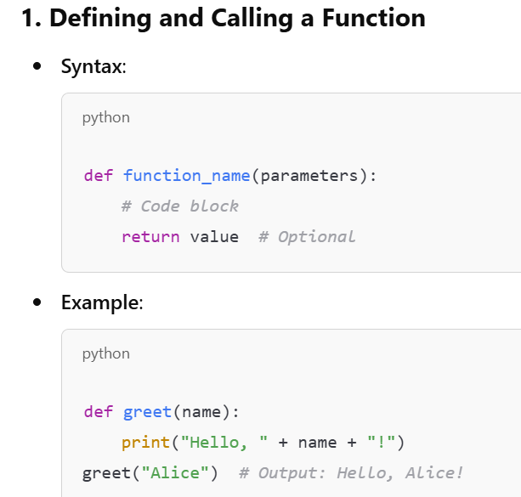
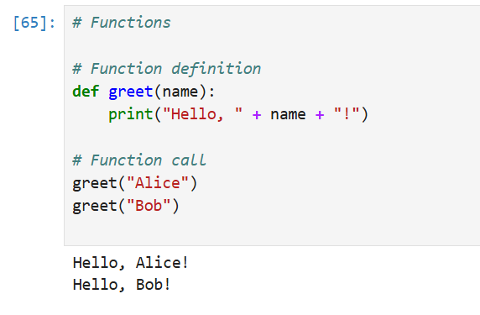
Functions

Slide 51

Functions – Parameters & Arguments
Parameters : Variables listed inside the parentheses in the function definition. They act as placeholders for the values (arguments) that will be passed when the function is called.
Arguments : The actual values passed to the function when it is called.

